Slide 1
Service Plan Searching Assistant
Search It(SI)
Group 4

Slide 2
Role
Sam, Ng Chi Kin | Project manager
Hugo, Wu Wei Jian | Software engineer
Leo, Tsui Ka Kin | Software engineer
Terry, Tam Kwan Leong | Software tester
Renee, Chan Ching Yi | Software tester

Slide 3
Presentation Overview
Project objective
Methdology
Work breakdown structure
Project schedule
Technology
System structure
Code refactoring
Testing strategies
Test model hierachy
Testing coverage
Bug report
Future enhancement
Demo
Q&A
Notes:
renee

Slide 4
Project Objective
self-service system
provide a platform
collecting mobile service plans
reduce searching time
advises
Notes:
renee

Slide 5
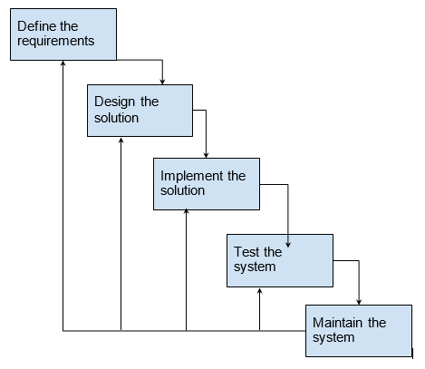
Methdology
Notes:
renee

Slide 6
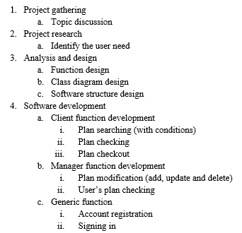
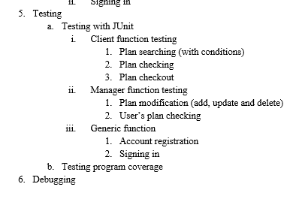
Work Breakdown Structure
Notes:
renee

Slide 7
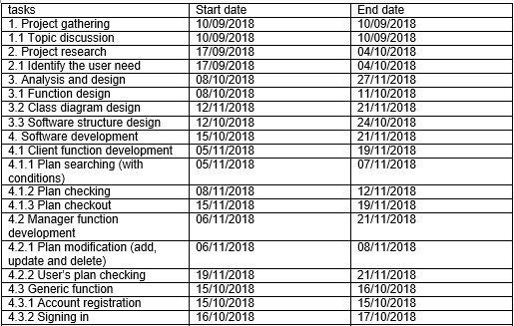
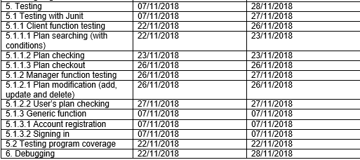
Proejct Schedule
Notes:
renee

Slide 8
Technology
Program Language
Eclipse IDE
JUnit
Github
Google Drive
Java
Notes:
renee

Slide 9
System Structures
Notes:
Sam

Slide 10
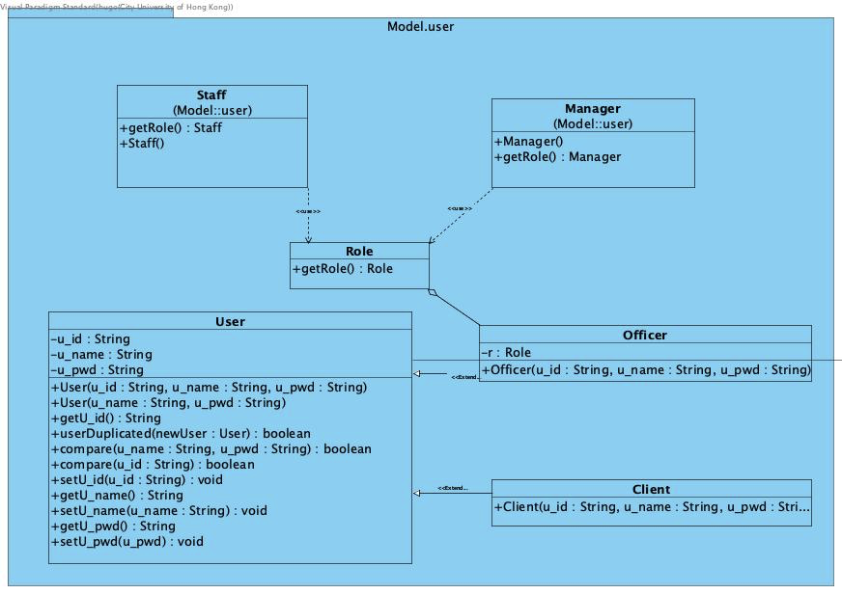
User Model Structure
Notes:
Sam

Slide 11
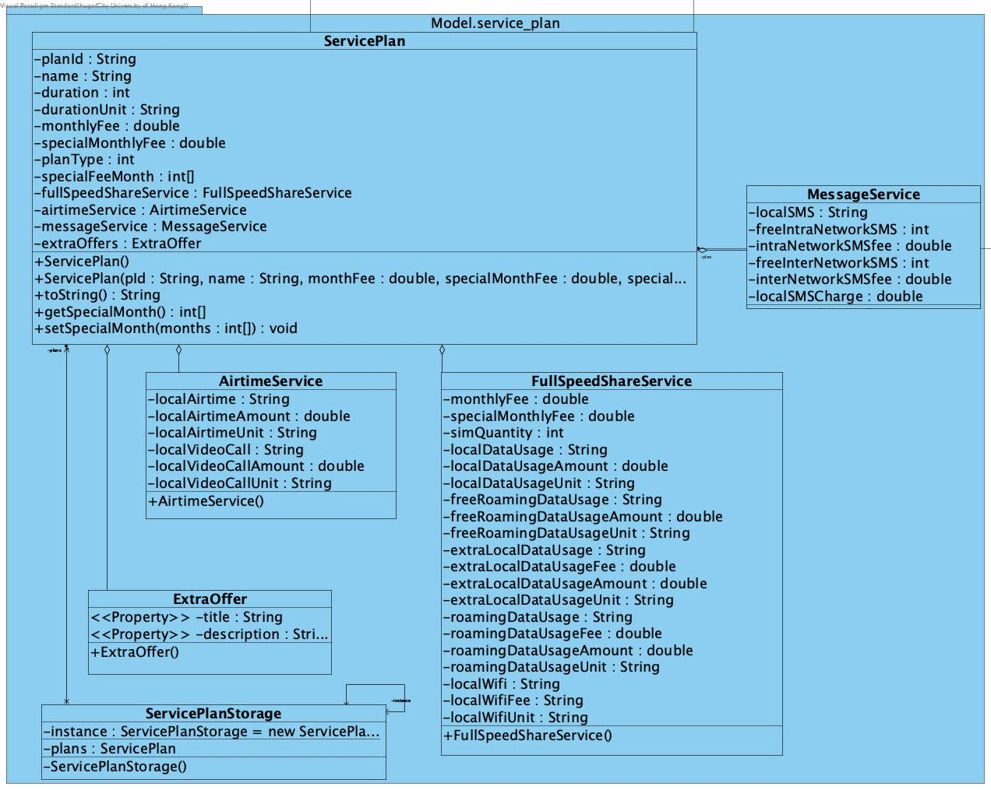
Service Plan Structure
Notes:
Sam

Slide 12
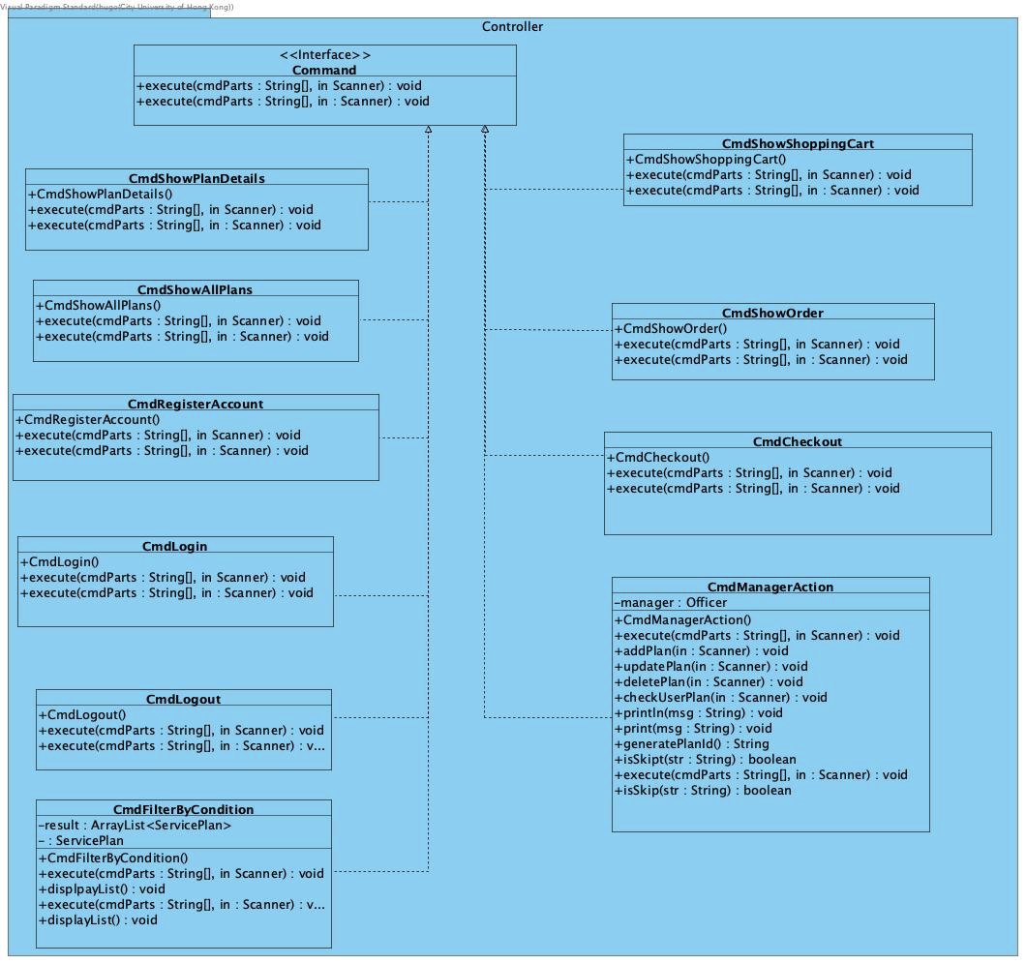
Command
Pattern
Notes:
Sam

Slide 13
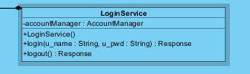
Login Service
Notes:
Sam

Slide 14
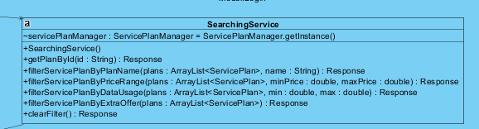
Searching Service
Notes:
Sam

Slide 15
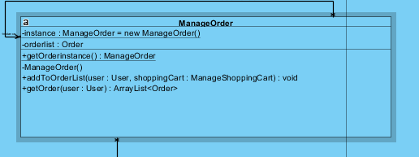
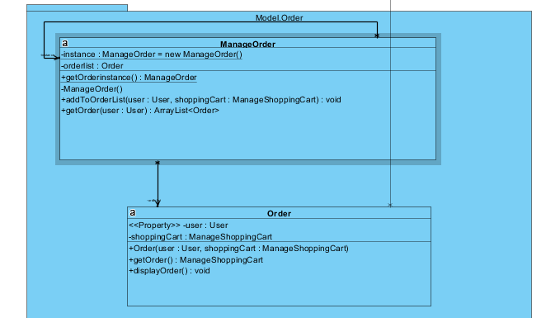
Order
Notes:
Sam

Slide 16
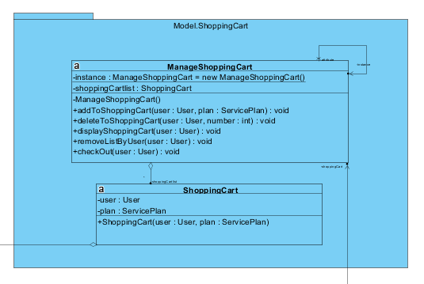
Shopping Cart
Notes:
Sam

Slide 17
Code Refactoring
Notes:
hugo

Slide 18
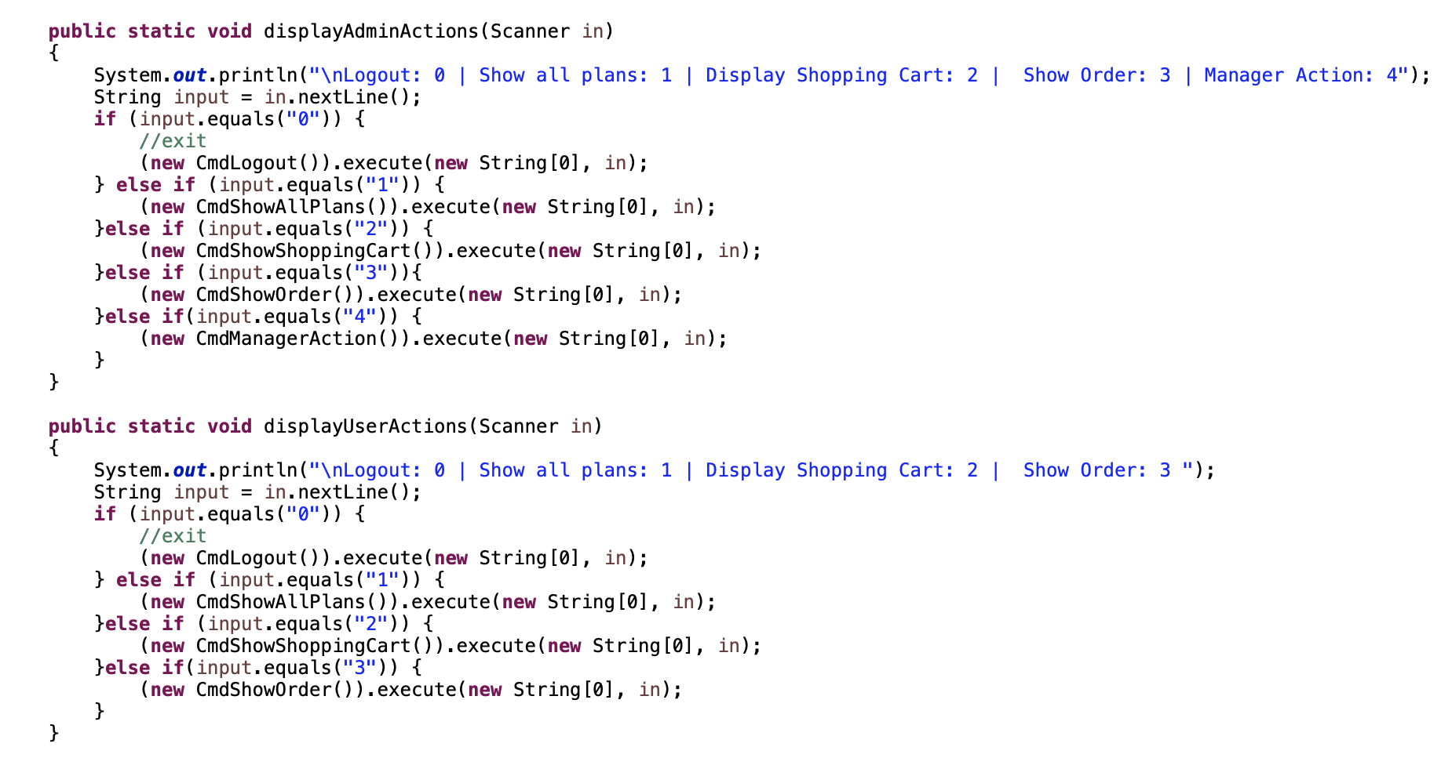
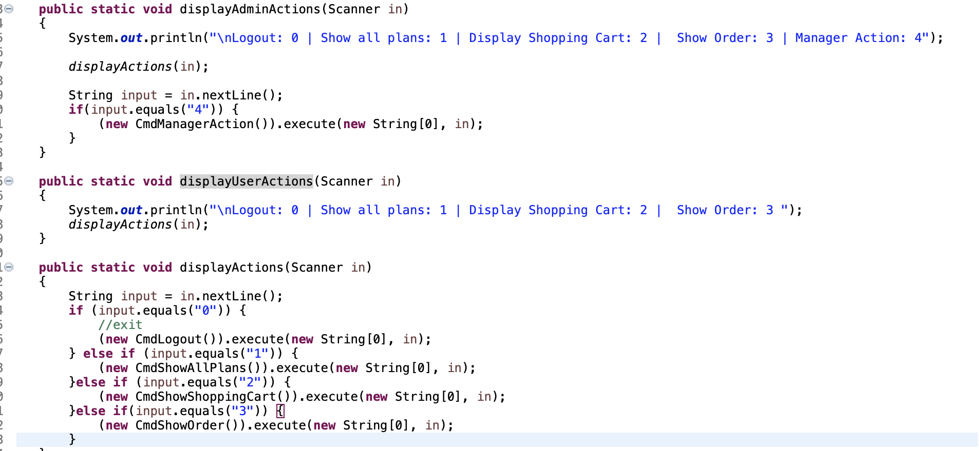
Execute Command (Code)
Notes:
hugo

Slide 19
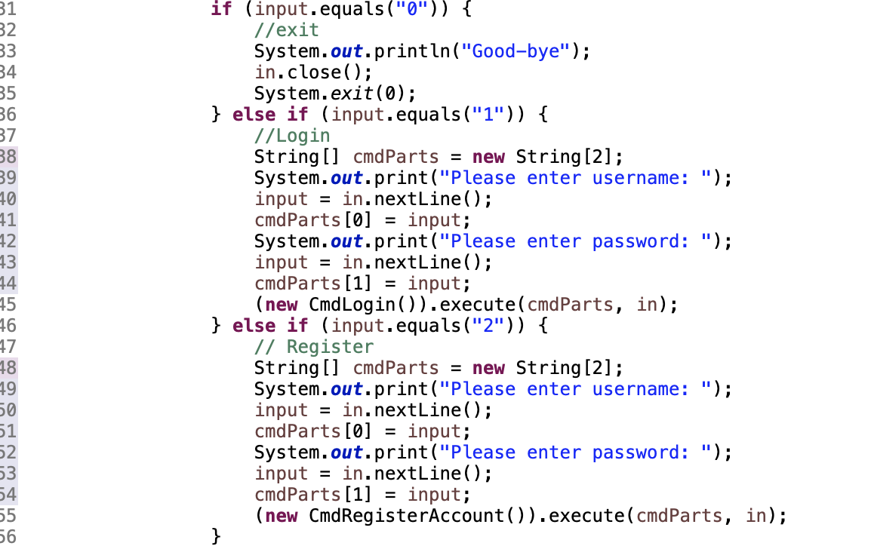
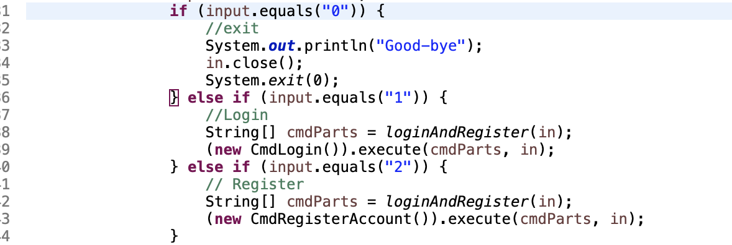
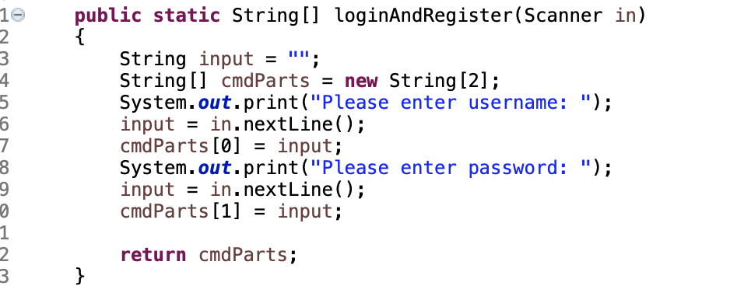
Login and Register (Code)
Notes:
hugo

Slide 20
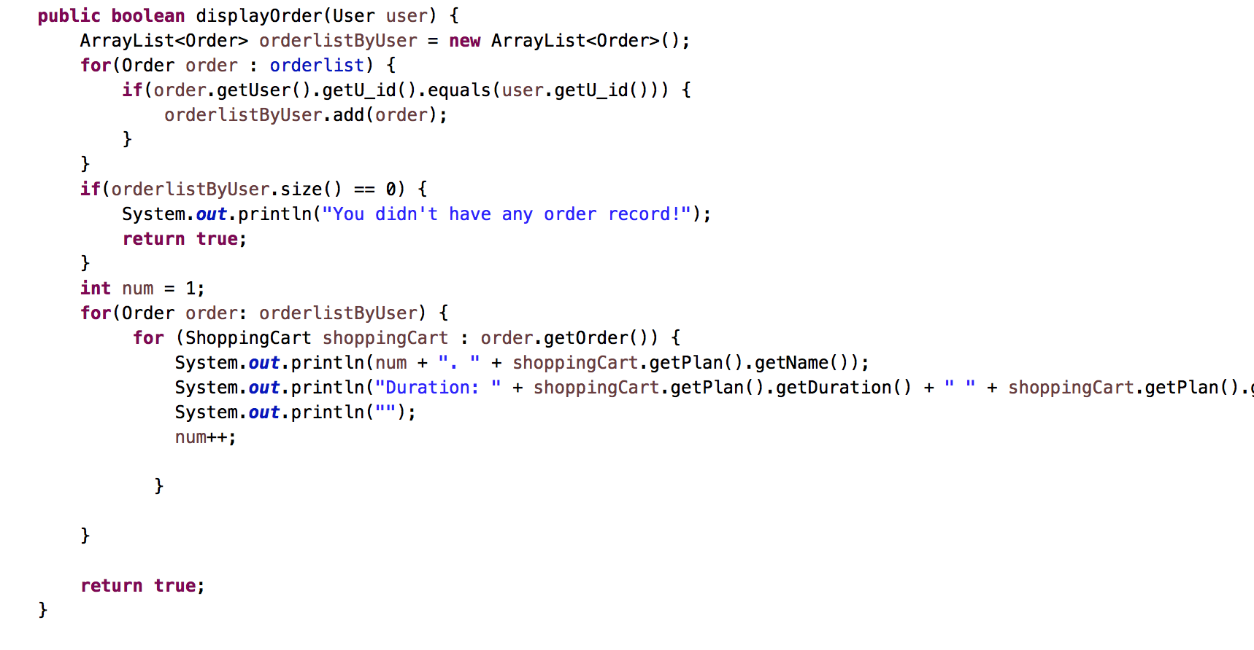
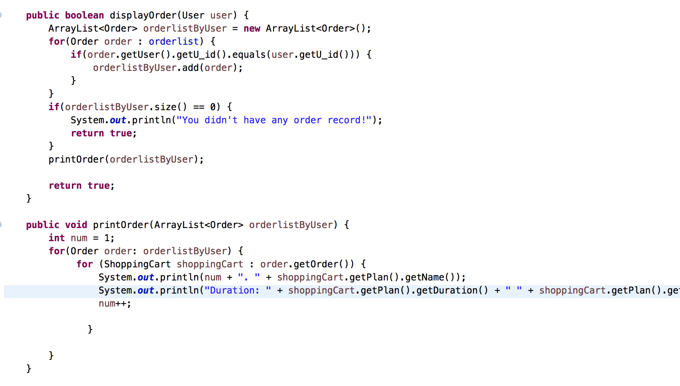
Show Order (Code)
Notes:
hugo

Slide 21
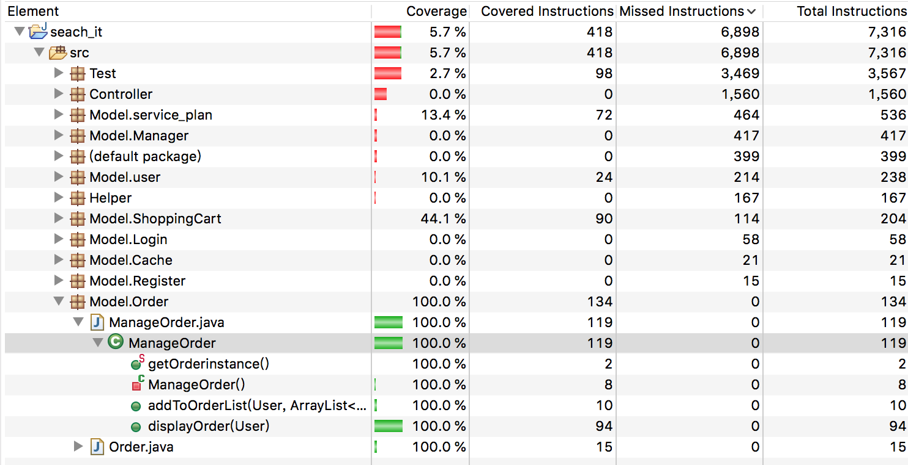
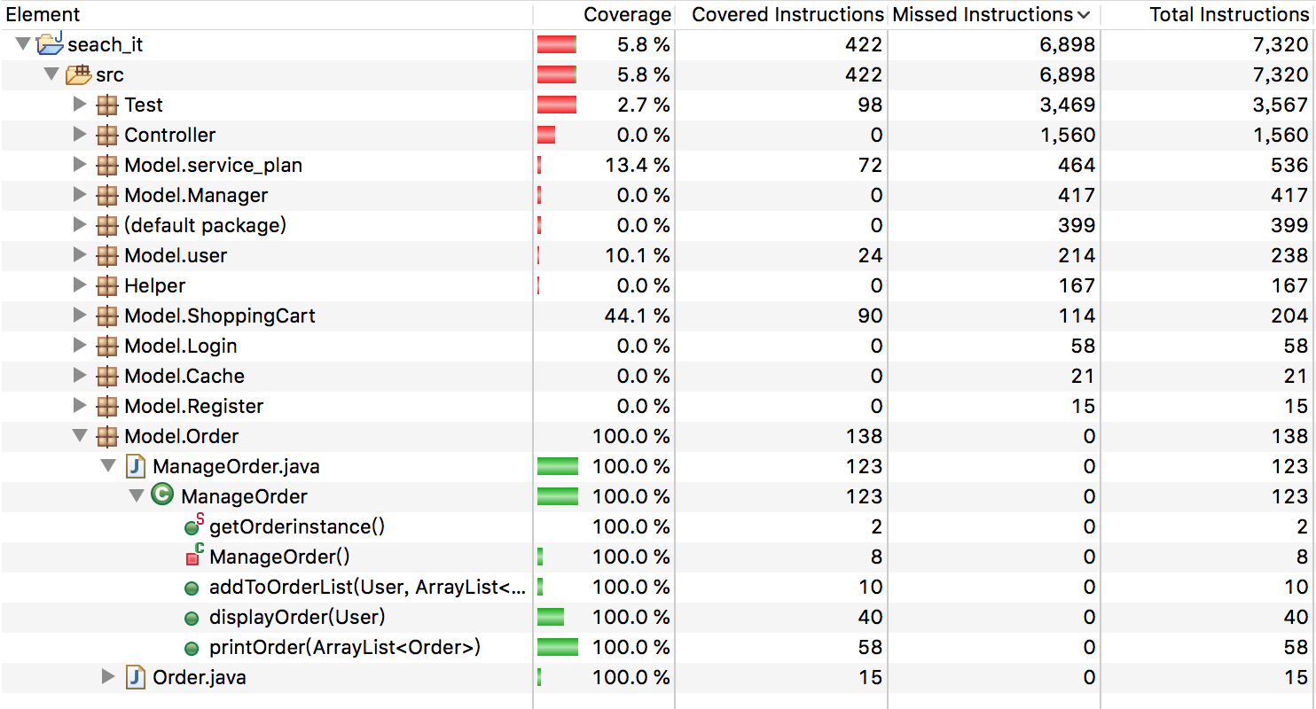
Show Order(Coverage)
Notes:
hugo

Slide 22
Testing Strategies
Bottom-up Approach
Notes:
leo

Slide 23
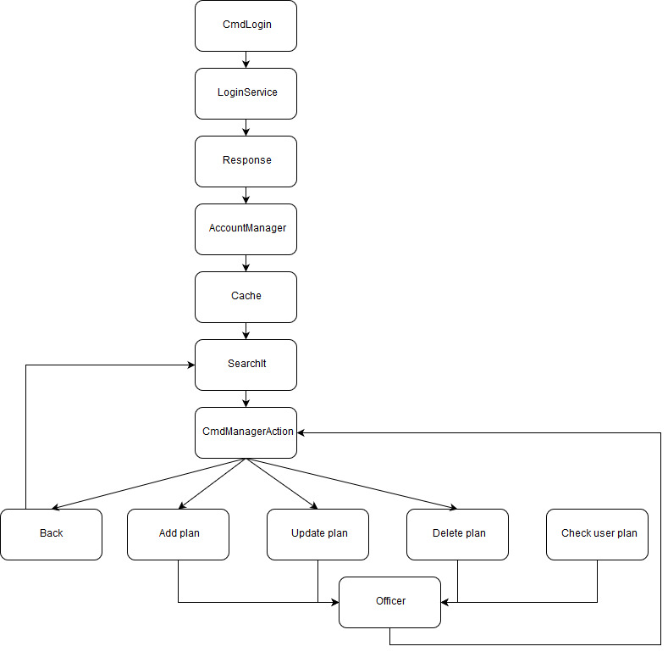
Test
Module
Hierachy
Notes:
leo

Slide 24
Coverage

Slide 25
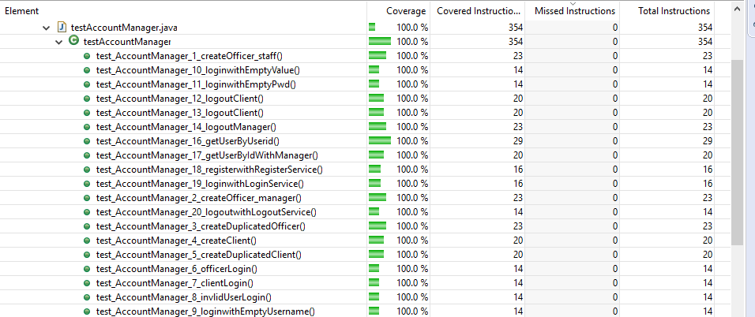
Test Case
Notes:
leo

Slide 26
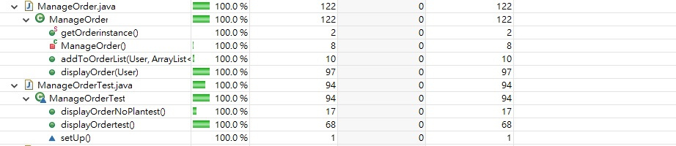
Test Case (CONT.)
Notes:
leo

Slide 27
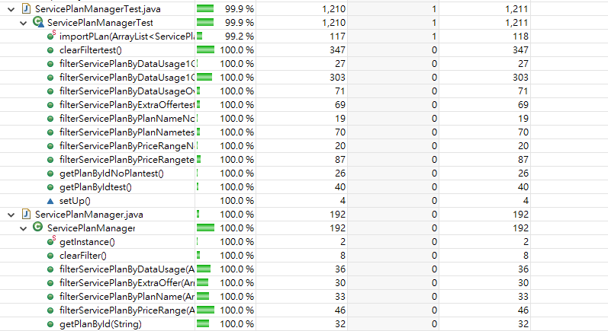
Integration Testing
Notes:
leo

Slide 28
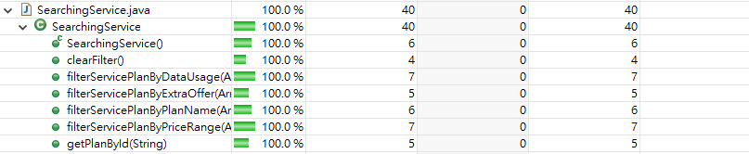
Integration Testing (CONT.)
Notes:
leo

Slide 29
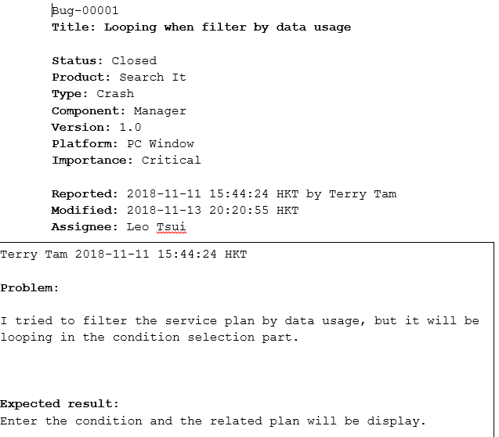
Bug Reports
Notes:
leo

Slide 30
Future Enhancement
Graphical user interface
Supports all platforms
Notes:
leo

Slide 31
Demostration
Notes:
terry

Slide 32
Q & A

